Slide 1
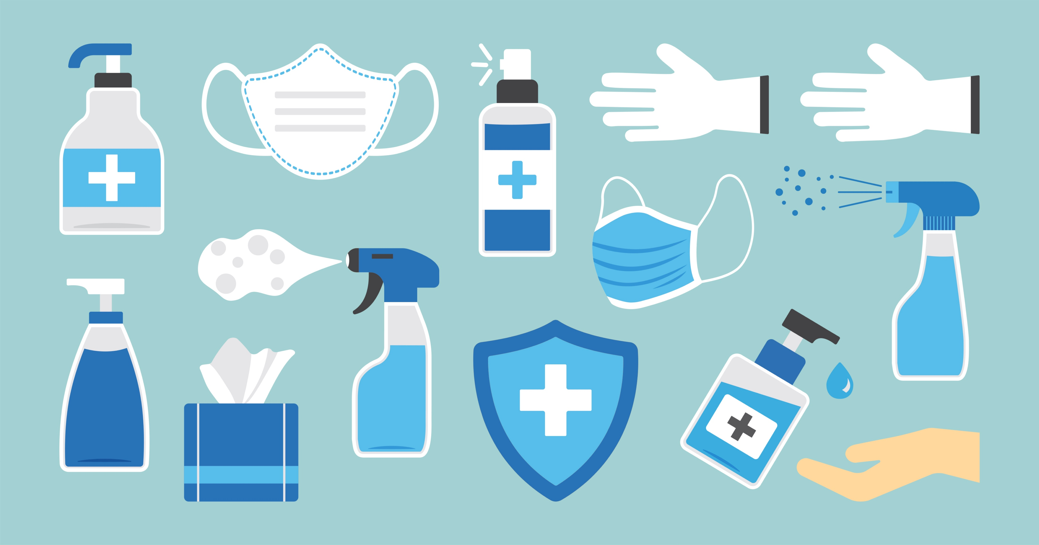
Follow Standard and Transmission-Based Precautions for Infection Prevention and Control in the Work Setting
HLTINF006 - Apply basic principles and practices of infection prevention and control (Release 1)

Slide 2


This presentation will examine the two types of infection prevention and control precautions.
These terms typically apply in a healthcare setting, but their ideas can still be contextualised in your workplace.
Standard-based precautions are applied to all patient care regardless of infection status.
Transmission-based precautions are taken in addition to standard-based precautions, done to prevent the spread of infection during a suspected or confirmed outbreak.
Follow Standard and Transmission-Based Precautions for Infection Prevention and Control in the Work Setting

Slide 3

2.1 Implement Personal Hygiene Practices

Slide 4

Below are examples of personal hygiene practices:
Observing personal care and cleanliness
Using clean clothing or uniform
Laundering and management of work clothing
Not attending work when ill
Observing safe respiratory and cough etiquette
Follow Standard and Transmission-Based Precautions for Infection Prevention and Control in the Work Setting

Slide 5
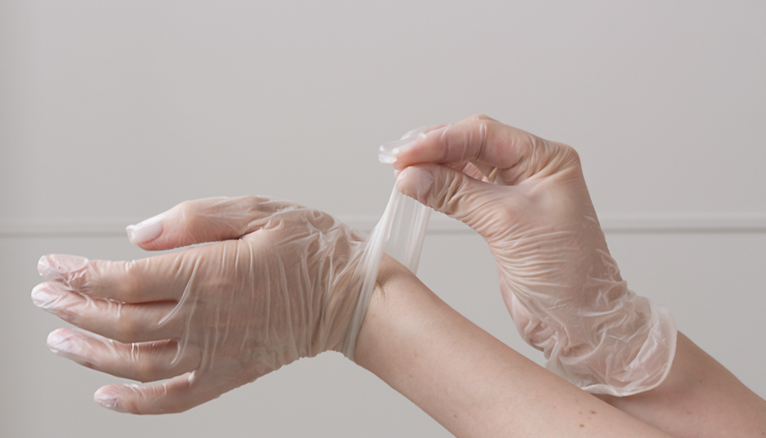
2.2 Practice Proper Hand Hygiene

Slide 6
2.2.1 Hand Care
Maintaining Intact Skin
The following are ways that help maintain intact skin:
Avoid using products that may irritate the skin.
Avoid washing hands with soap and water immediately before or after using an alcohol-based hand rub.
Ensure that hands are completely dry and clean before donning gloves.
Avoid using hot water for handwashing.
Use moisturisers regularly.
Follow Standard and Transmission-Based Precautions for Infection Prevention and Control in the Work Setting

Slide 7

Rehydrate your skin on a regular basis with creams and lotions to avoid or reduce skin dryness or irritation.
Consider the following when choosing products:
Avoid products containing scents, colours and preservatives.
Consider any product’s tolerance, feel, and smell.
Use emollient-containing alcohol-based hand rubs (ABHR).
Follow Standard and Transmission-Based Precautions for Infection Prevention and Control in the Work Setting

Slide 8
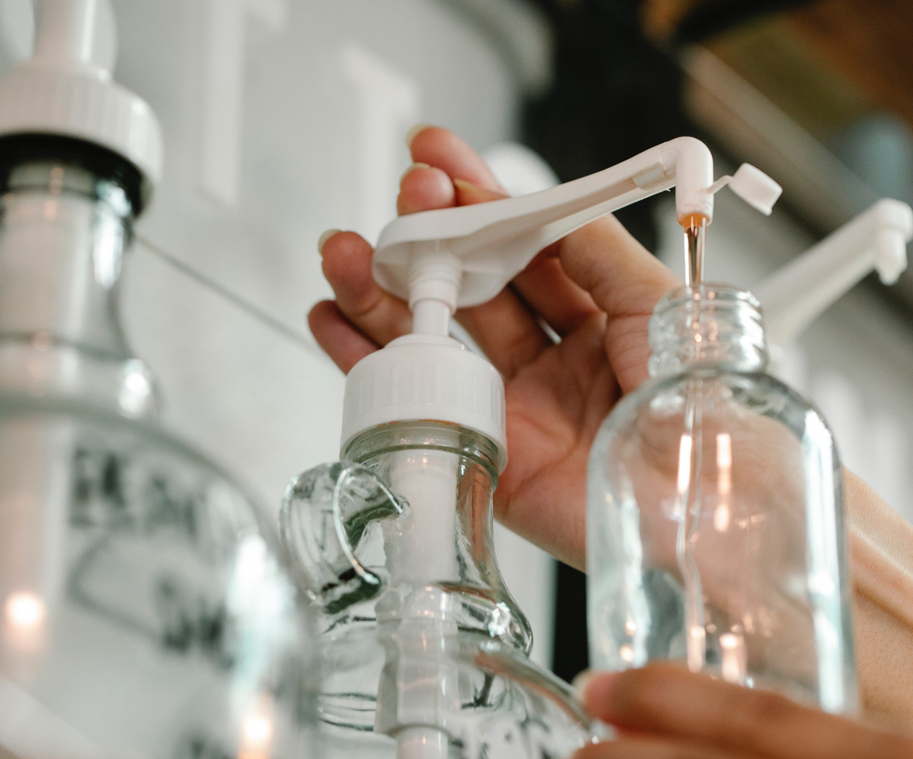
Correct handwashing and hand-rubbing practices:
Do not use an ABHR after washing your hands with soap and water.
Only wear gloves when the hands are dry.
Do not use hot water for handwashing.
Consider the quality of the paper towels to avoid irritating the skin.
Follow Standard and Transmission-Based Precautions for Infection Prevention and Control in the Work Setting

Slide 9

Educate others by doing the following:
Display posters and information about proper hand care, including handwashing and hand rubbing, in visible areas whenever possible.
Include hand care measures in HCW education initiatives.
Follow Standard and Transmission-Based Precautions for Infection Prevention and Control in the Work Setting

Slide 10
Management of Non-Intact Skin
Management of abrasions
Make sure that the wound is clean
Use an antiseptic such as Betadine
Use a non-stick sterile dressing to cover the wound
Change the dressing according to the manufacturer’s instructions
If you reapplied the antiseptic, wash it off after five minutes and then re-dress the wound
Follow Standard and Transmission-Based Precautions for Infection Prevention and Control in the Work Setting

Slide 11
Management of Non-Intact Skin
Management of cuts
Control the bleeding using a clean towel to apply light pressure to the wound
Do this until the bleeding stops
Rinse the wound with running water
Sanitise your hands before proceeding to clean or dress the wound
Follow Standard and Transmission-Based Precautions for Infection Prevention and Control in the Work Setting

Slide 12
Management of Non-Intact Skin
Management of cuts
Cover the wound with a non-stick sterile dressing
Change the dressing according to the manufacturer’s instructions
If you reapplied the antiseptic, wash it off after five minutes and then re-dress the wound
Follow Standard and Transmission-Based Precautions for Infection Prevention and Control in the Work Setting

Slide 13
Some other things to consider when treating a wound:
When removing dirt and debris from the wound, use clean water and soap if available.
When wiping away blood, dirt, or debris from the wound, wipe from the centre going out of the wound to prevent further foreign material from being introduced.
Pat dry the wound with fresh, dry gauze.
If the wound continues to bleed through the initial dressing, apply a second dressing on top of the first one.
Follow Standard and Transmission-Based Precautions for Infection Prevention and Control in the Work Setting

Slide 14

Follow these practices to reduce the risk of infection:
Cover open cuts, sores or abrasions with bandages before starting work.
Consider wearing gloves to protect the skin.
Use barrier creams and lotion to keep skin healthy and hydrated.
Follow Standard and Transmission-Based Precautions for Infection Prevention and Control in the Work Setting

Slide 15
2.2.2 Hand Hygiene Procedures
The materials, techniques, and precautions related to hand washing and rubbing are all part of hand hygiene routines.
This is in reference to the following:
Hand hygiene products
Hand hygiene techniques
Hand rubbing procedures
Precautions
Follow Standard and Transmission-Based Precautions for Infection Prevention and Control in the Work Setting

Slide 16
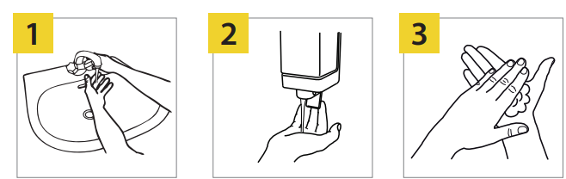
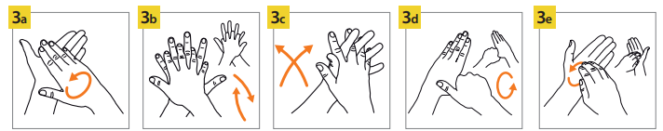
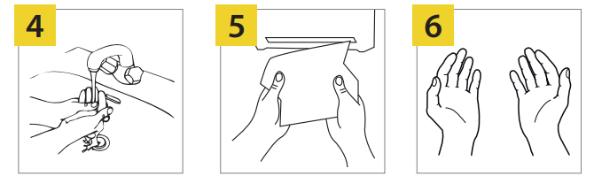
The image below illustrates how to perform handwashing:
Follow Standard and Transmission-Based Precautions for Infection Prevention and Control in the Work Setting

Slide 17
The steps to handwashing are as follows:
Wet your hands with clean, running water (preferably warm).
Turn off the tap and apply soap to the hands.
Lather your hands by rubbing them together with the soap, including:
Palm to palm
Back of hands
In between fingers and back fingers
Follow Standard and Transmission-Based Precautions for Infection Prevention and Control in the Work Setting

Slide 18


The steps to handwashing are as follows:
Around thumbs
Tips of fingers
Rinse your hands well under clean, running water.
Dry your hands using a clean towel or air dry them.
Follow Safe Work Practices for Infection Control

Slide 19
2.2.3 Five Moments of Hand Hygiene
Below are the five moments of hand hygiene:
1
2
3
4
5
Before touching a patient
Before conducting a procedure
After conducting a procedure or an exposure risk to body substances
After touching a patient
After touching the patient's surroundings
Follow Standard and Transmission-Based Precautions for Infection Prevention and Control in the Work Setting

Slide 20

2.3 Use the Correct Personal Protection Equipment (PPE)

Slide 21
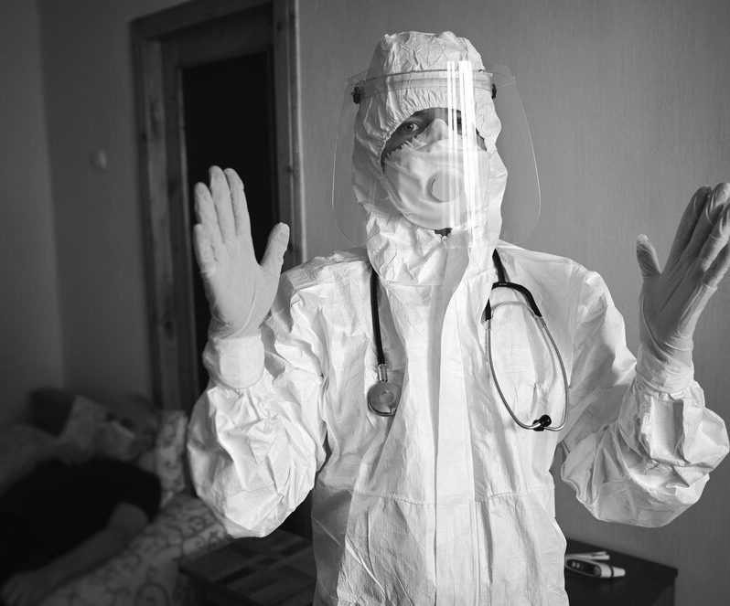
When choosing the type of PPE to be used, consider the following factors:
Risks to health and safety
Task or activity to be performed
Requirements of relevant standards and codes of practice
Follow Standard and Transmission-Based Precautions for Infection Prevention and Control in the Work Setting

Slide 22
When choosing the type of PPE to be used, consider the following factors:
Size, fit and comfort for the person wearing the PPE
Compliance with applicable standards
NSQHS Standards
Standards Australia
Australian Guidelines for the Prevention and Control of Infection in Healthcare
Follow Standard and Transmission-Based Precautions for Infection Prevention and Control in the Work Setting

Slide 23
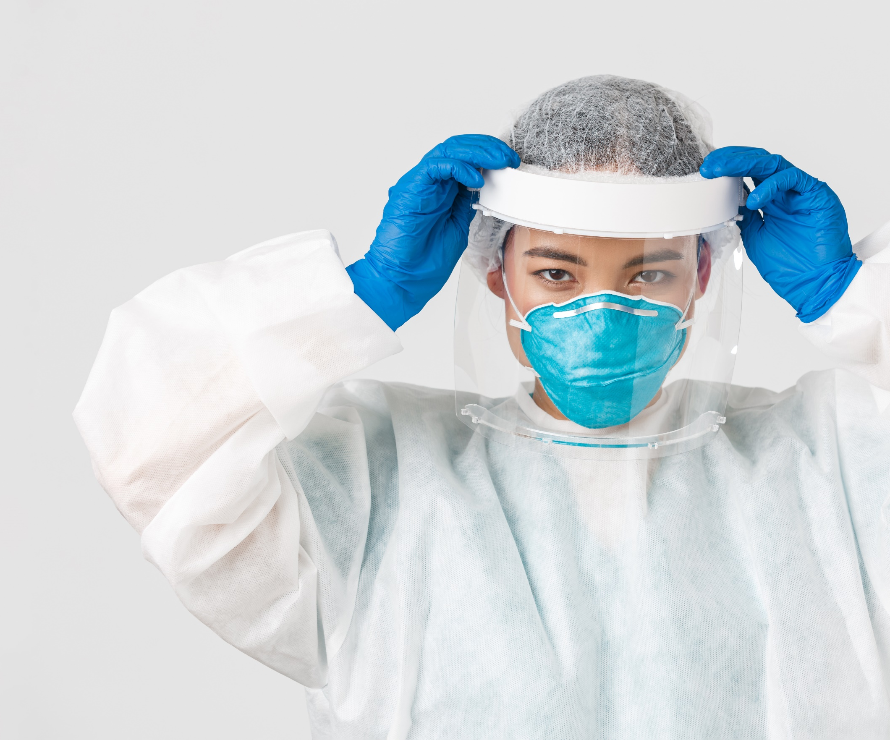
General PPE Guidelines
PPE must be worn in this sequence:
Gowns and aprons
Masks
Protective eyewear and face shields
Gloves
Follow Standard and Transmission-Based Precautions for Infection Prevention and Control in the Work Setting

Slide 24
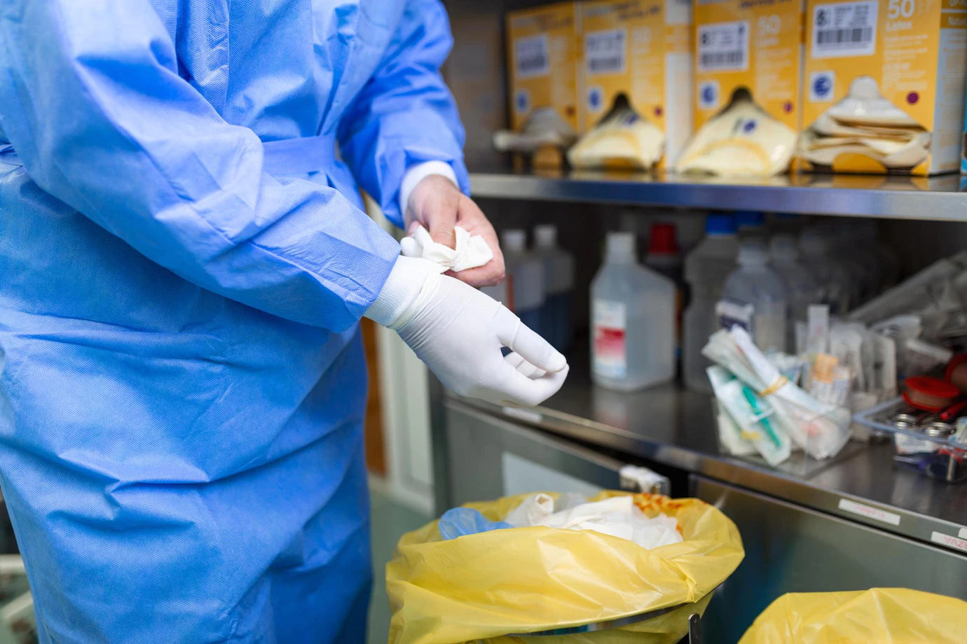
PPE must be removed in this sequence:
Gloves
Protective eyewear and face shields
Gowns and aprons
Masks
Follow Standard and Transmission-Based Precautions for Infection Prevention and Control in the Work Setting

Slide 25
2.3.1 Gloves
Gloves are worn at the following times:
Anticipating direct contact with blood or body substances, mucous membranes, non-intact skin and other potentially infectious materials
Handling visibly soiled or potentially contaminated equipment
Anticipating potential exposure to toxic drugs
Using chemicals when cleaning
Follow Standard and Transmission-Based Precautions for Infection Prevention and Control in the Work Setting

Slide 26
Important Guidelines on Using Gloves Correctly
Perform hand hygiene should be done before and after using gloves.
Change gloves between conducting clean and dirty procedures.
Change gloves after continuous use.
Do not reuse disposable gloves.
Do not wear gloves when touching the telephone, keyboards, doors, linens or surfaces other people touch to avoid cross-contamination.
Follow Standard and Transmission-Based Precautions for Infection Prevention and Control in the Work Setting

Slide 27
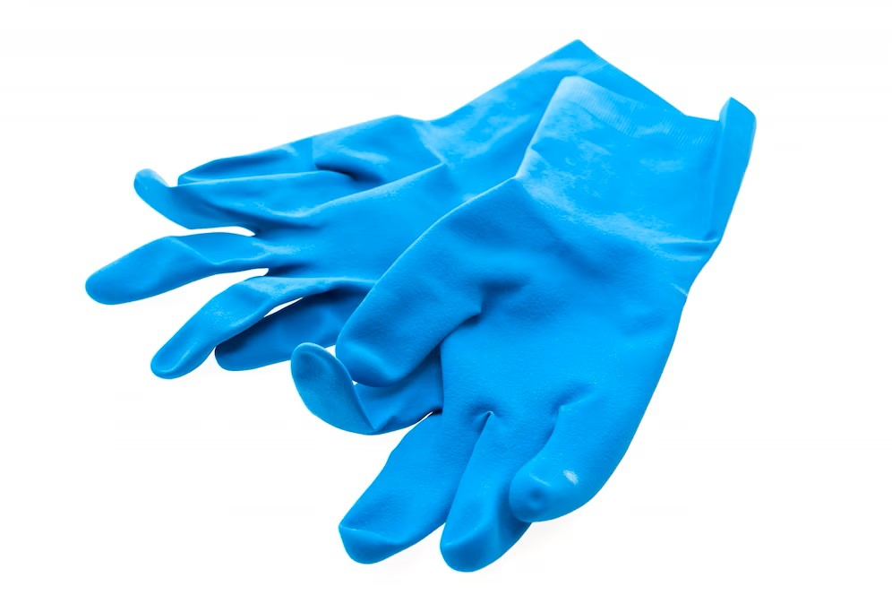
Types of Gloves
Below are the list of most common type of gloves used as PPE:
Patient examination gloves
Surgeon's gloves
Non-medical gloves
Follow Standard and Transmission-Based Precautions for Infection Prevention and Control in the Work Setting

Slide 28

Fitting of Gloves
Perform hand hygiene.
Remove gloves one at a time from the box or packaging, holding the top of the cuff.
Put your hand through the glove opening and pull it up to the wrist.
Repeat the same procedure with the second hand.
Adjust gloves to cover wrists or gowns as required.
Follow Standard and Transmission-Based Precautions for Infection Prevention and Control in the Work Setting

Slide 29

Removing and Disposing of Gloves
Grasp the palm area of the other gloved hand and peel off the first glove using a gloved hand.
Hold the removed glove in the gloved hand.
Slide fingers of ungloved hand under remaining glove at wrist and peel off second glove over the first glove.
Discard gloves in a waste container.
Perform hand hygiene.
Follow Standard and Transmission-Based Precautions for Infection Prevention and Control in the Work Setting

Slide 30
2.3.2 Masks
Important Guidelines on How to Use Masks Correctly
Change your mask when it becomes soiled or wet.
Do not touch your mask while wearing it.
Never reuse disposable masks. Do not fold it or put it in your pocket for later use.
Never reapply when it has already been removed.
Do not let it dangle around your neck.
Discard your mask in the appropriate waste disposal area.
Follow Standard and Transmission-Based Precautions for Infection Prevention and Control in the Work Setting

Slide 31
Types of Masks
Below are the types of masks that are commonly used:
Particulate filter respirators
Surgical mask
Utility mask
Cloth mask
Follow Standard and Transmission-Based Precautions for Infection Prevention and Control in the Work Setting

Slide 32
Grades of Mask
Only surgical and particulate filter respirator masks are medical grade among the types used for infection control.
Mask Level or Grade | Description
1 | It is for general use and not meant for aerosols, sprays or fluids.
2 | It provides moderate protection against aerosols or fluids
3 | It provides maximum protection against aerosols or fluids.
Follow Standard and Transmission-Based Precautions for Infection Prevention and Control in the Work Setting

Slide 33
Fitting Surgical Masks
Follow these three steps to fit surgical masks:
Position the mask over your mouth and nose
Fasten the ties or tapes above and below your ears at the back of your head
Fit flexible band to nose bridge
Follow Standard and Transmission-Based Precautions for Infection Prevention and Control in the Work Setting

Slide 34
Fitting P2 Respirators
To fit check respirators, below are the steps:
Position respirator over mouth and nose
Place tapes above and below the ears at the back of the head
Adjust fit
Follow Standard and Transmission-Based Precautions for Infection Prevention and Control in the Work Setting

Slide 35
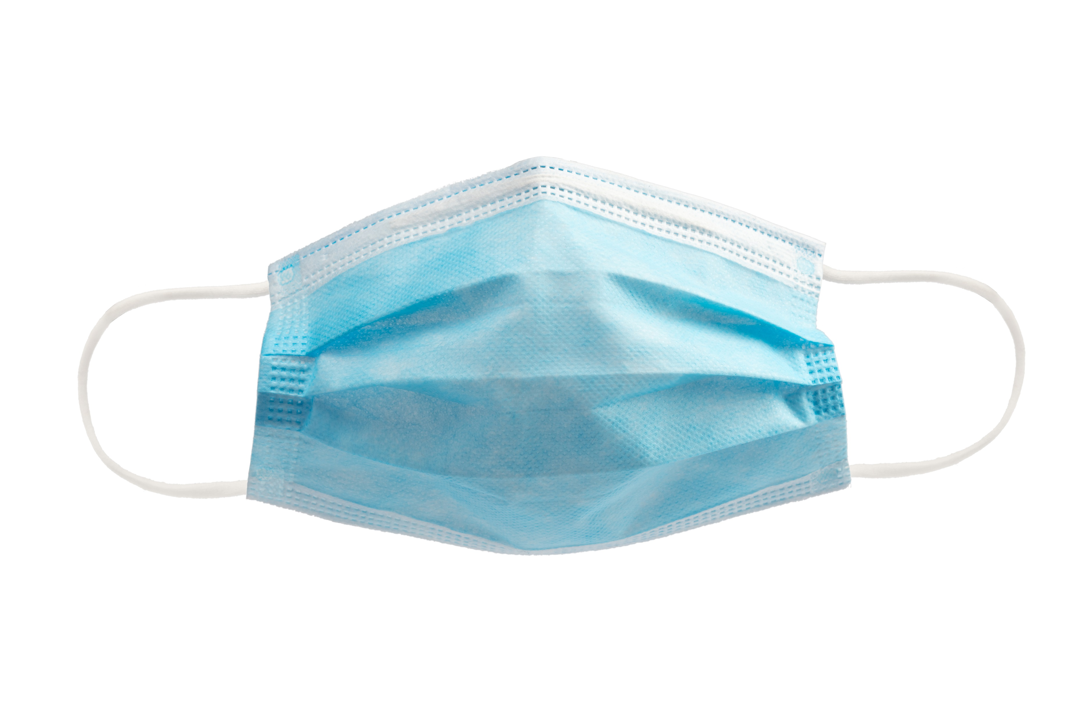
Removing and Disposing of Masks
Using clean hands, untie or break the ties at the back of your hand.
Touch only the ties of the masks and discard them in the designated waste disposal.
Perform hand hygiene.
Follow Standard and Transmission-Based Precautions for Infection Prevention and Control in the Work Setting

Slide 36
2.3.3 Protective Eyewear and Face Shields
Protective Eyewear
Below are guidelines on how to use eye protection correctly:
Dispose of disposable eyewear immediately in the proper disposal area.
Send reusable eye protection to a central area for reprocessing before it can be used again.
Choose eye protection that does not interfere with visual acuity.
Choose a size that securely protects you from splashes from the side.
Follow Standard and Transmission-Based Precautions for Infection Prevention and Control in the Work Setting

Slide 37
Types of Eye Protection
Fitting of Protective Eyewear
Pick up the eyewear using the temples.
Use both hands to open the temples.
Place the eyewear over your eyes, making sure that the bridge rests comfortably on your nose and the temple tips are securely hooked over your ears.
Goggles
Safety glasses
Follow Standard and Transmission-Based Precautions for Infection Prevention and Control in the Work Setting

Slide 38
Face Shields
Below are guidelines on how to use face shields properly:
Wear face shields during activities that can likely generate splashes.
You must also wear face shields for any wound irrigation where there is a risk of sprays of splashes.
Never push the face shield up while working.
Ensure your face shield’s straps are securely tightened so the face shield will not drop.
Follow Standard and Transmission-Based Precautions for Infection Prevention and Control in the Work Setting

Slide 39
Types of Face Shields
Fitting of Face Shields
Bend forward and hold on to the straps of the face shield with both hands.
Place the elastic behind your head so the foam rests on your forehead.
Check the face shield to make sure it covers all areas of the face.
Disposable
Reusable
Follow Standard and Transmission-Based Precautions for Infection Prevention and Control in the Work Setting

Slide 40
Removal and Disposal of Protective Eyewear and Face Shields
Remove goggles or face shield from the back by lifting the headband and without touching the front of the goggles or face shield.
Place reusable items in the designated receptacle for reprocessing. Otherwise, discard it in a waste container.
Perform hand hygiene afterwards if hands become contaminated during PPE removal.
Follow Standard and Transmission-Based Precautions for Infection Prevention and Control in the Work Setting

Slide 41
Grades of Protective Eyewear and Face Shields
They are rated on how they respond to the impact of a specific weight ball.
These grades may include any of the following:
Low impact
Medium impact
High impact
Extra high impact
Follow Standard and Transmission-Based Precautions for Infection Prevention and Control in the Work Setting

Slide 42
2.3.4 Protective Clothing
Types of Protective Clothing
Plastic apron
Gown
Full body gown
Sterile gown
Follow Standard and Transmission-Based Precautions for Infection Prevention and Control in the Work Setting

Slide 43
Fitting Protective Clothing
Put on the gown. Fully cover the torso from the neck to the knees and arms to the end of your wrists. Wrap around the back.
Fasten the ties at the neck and the back.
Tuck your sleeves under the glove cuffs of the gown.
Follow Standard and Transmission-Based Precautions for Infection Prevention and Control in the Work Setting

Slide 44
Removing and Disposing of Protective Clothing
Using clean hands, untie or break your back and neck ties.
Pull from the neck and shoulders, then arms.
Turn the gown inside out as you remove it.
Roll the gown into a bundle.
Discard the gown into the designated waste container.
Wash hands.
Follow Standard and Transmission-Based Precautions for Infection Prevention and Control in the Work Setting

Slide 45
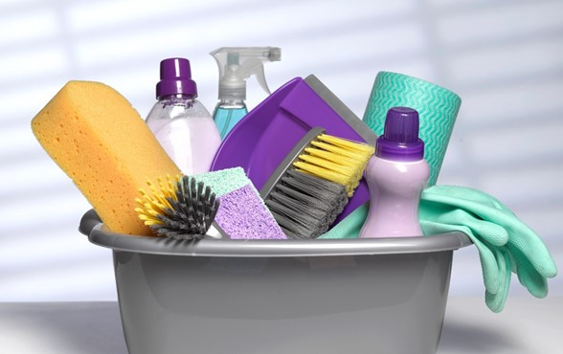
2.4 Follow Procedures for Environmental Cleaning and Management of Waste

Slide 46
2.4.1 Environmental Cleaning
Below are a few of the activities performed when cleaning:
Removing waste
Damp dusting
Mopping
Washing
Drying
Follow Standard and Transmission-Based Precautions for Infection Prevention and Control in the Work Setting

Slide 47
Be familiar with the methods for conducting surface cleaning:
Wet or soak a fresh cleaning cloth in the environmental cleaning solution.
Fold the cleaning cloth in half until it is about the size of your hand. This will ensure that you can use all of the surface area efficiently.
Wipe surfaces using the general strategies as above (e.g., clean to dirty, high to low, systematic manner), making sure to use mechanical action and making sure that the surface is thoroughly wetted to allow required contact time.
Follow Standard and Transmission-Based Precautions for Infection Prevention and Control in the Work Setting

Slide 48
Be familiar with the methods for conducting surface cleaning:
Regularly rotate and unfold the cleaning cloth to use all of the sides.
When all of the sides of the cloth have been used or when it is no longer saturated with solution, dispose of the cleaning cloth or store it for reprocessing.
Repeat the first step.
Follow Standard and Transmission-Based Precautions for Infection Prevention and Control in the Work Setting

Slide 49

Cleaning Schedule
A cleaning schedule is made up of two parts:
Cleaning frequency – This refers to how often cleaning must be done.
Cleaning method – This refers to the products and processes to be used when cleaning.
Follow Standard and Transmission-Based Precautions for Infection Prevention and Control in the Work Setting

Slide 50
2.4.2 Equipment Cleaning
Equipment cleaning is the removal of pathogens and debris from work equipment.
The following equipment types and descriptions are provided:
Critical equipment
These puncture to the skin or mucous membranes.
Semi-critical equipment
These make contact with the mucous membranes or non-intact skin.
Non-critical equipment
These are frequently touched by healthcare workers and patients, and often shared between patients.
Follow Standard and Transmission-Based Precautions for Infection Prevention and Control in the Work Setting

Slide 51
2.4.3 Management of Linen and Clothing
The following are the principles set by the Australian Guidelines that you must follow:
Use appropriate PPE is worn during the handling of soiled linen.
Used linen is 'bagged' at the location of use into an appropriate laundry receptacle.
Used linen must not be rinsed or sorted in patient care areas or washed in domestic washing machines.
Soiled linen should be placed into leak-proof laundry bags.
Hand hygiene is performed following the handling of used linen.
Follow Standard and Transmission-Based Precautions for Infection Prevention and Control in the Work Setting

Slide 52

Observe the following measures when handling a patient's personal possessions, such as clothing:
Use a domestic-type washing machine.
Use the appropriate detergent and hot water when washing.
Wash loads one at a time if hot water is unavailable.
Use clothes dryers for drying.
Follow Standard and Transmission-Based Precautions for Infection Prevention and Control in the Work Setting

Slide 53

Follow the process below when handling used linen and clothing:
Collecting
Transporting
Processing
Storing
Follow Standard and Transmission-Based Precautions for Infection Prevention and Control in the Work Setting

Slide 54
2.4.4 Managing a Blood or Body Fluid Spill
Below are the key principles for managing blood and body fluids:
Blood and body fluid or substance spills should be dealt with immediately.
Spills should be attended to as soon as it is safe in operating rooms or in circumstances where medical procedures are underway.
Care must be taken to thoroughly clean and dry areas where there is any possibility of bare skin contact with the surface.
PPE should be used for all cleaning procedures, disposed of, or sent for cleaning after use. Hands must be washed and dried after cleaning.
Follow Standard and Transmission-Based Precautions for Infection Prevention and Control in the Work Setting

Slide 55
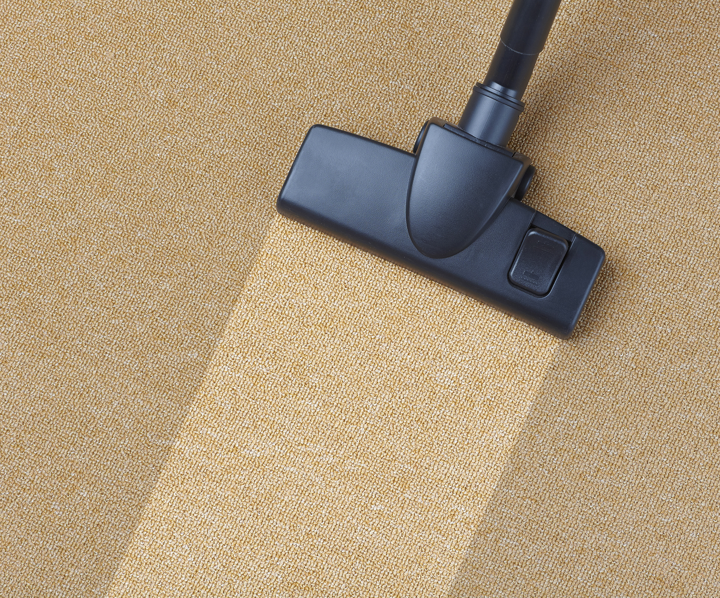
Below are the key principles for managing blood and body fluids:
Where a spill occurs on a carpet, shampoo as soon as possible; do not use disinfectant. Steam cleaning may be used instead.
Wash hands thoroughly after cleaning is completed.
Follow Standard and Transmission-Based Precautions for Infection Prevention and Control in the Work Setting

Slide 56
Do the following steps when dealing with blood and bodily fluid spills:
Wear appropriate PPE
Confine the spill and wipe it up immediately with absorbent towels, cloths, or absorbent granules that are spread over the spill to solidify the blood or body fluid. These should then be disposed of as infectious waste afterwards.
Follow Standard and Transmission-Based Precautions for Infection Prevention and Control in the Work Setting

Slide 57
Do the following steps when dealing with blood and bodily fluid spills:
Clean thoroughly using neutral detergent and warm water solution.
Disinfect by using a facility-approved intermediate-level disinfectant.
Immediately send all reusable supplies and equipment (e.g. cleaning cloths, mops) for reprocessing (i.e. cleaning and disinfection) after the spill is cleaned up.
Follow Standard and Transmission-Based Precautions for Infection Prevention and Control in the Work Setting

Slide 58
2.4.5 Reprocessing Reusable Equipment or Instruments
Single-Use Medical Equipment
If you see a symbol of the number '2' crossed out with a slash sign, the equipment is designed for single use only.
They must not be recycled or reused in any form.
Follow Standard and Transmission-Based Precautions for Infection Prevention and Control in the Work Setting

Slide 59
Spaulding Classification of Equipment
This classification is based on the risk level for infection with the usage of the device.
Shown below is the level of reprocessing associated with each association:
Critical equipment
Semi-critical equipment
Non-critical equipment
Cleaning followed by sterilization
Cleaning followed by high-level disinfection
Cleaning followed by low-level disinfection
Follow Standard and Transmission-Based Precautions for Infection Prevention and Control in the Work Setting

Slide 60
Know the general procedures for recycling crucial reusable medical devices:
Clean thoroughly as soon as possible after using.
Sterilise after cleaning by steam under pressure.
Sterilise through an automated low-temperature chemical sterilant system, other liquid chemical sterilant or ethylene oxide sterilisation. Do this if the equipment is heat or moisture sensitive
Ensure critical items are sterilised between each patient use.
Follow Standard and Transmission-Based Precautions for Infection Prevention and Control in the Work Setting

Slide 61
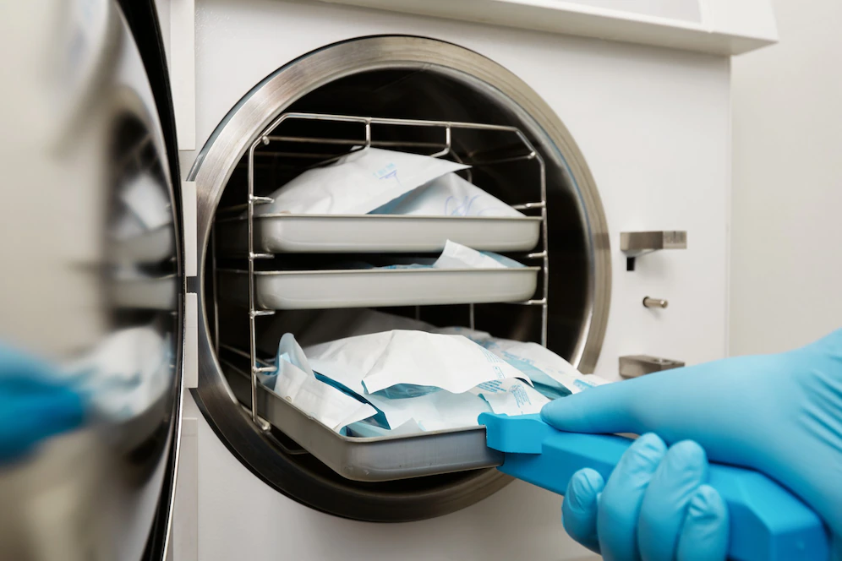
The steps for reprocessing semi-critical reusable medical devices are as follows:
Clean thoroughly as soon as possible after using.
Steam sterilisation is preferable.
Use a high-level TGA-recommended chemical or thermal sterilant or medical device disinfectant. Do this if the equipment could not tolerate steam.
Follow Standard and Transmission-Based Precautions for Infection Prevention and Control in the Work Setting

Slide 62
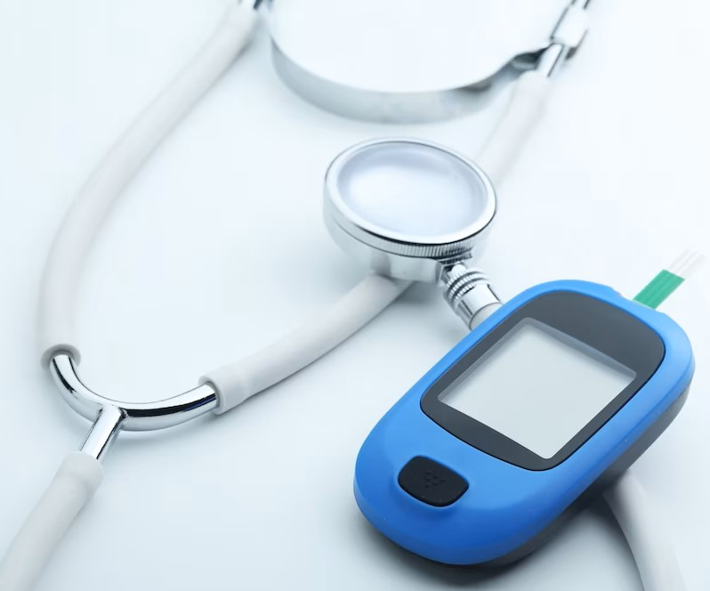
The two actions for reprocessing non-critical reusable medical devices are:
Clean as necessary with a detergent solution.
Disinfect with compatible low or intermediate-level TGA-included sterilant or medical device disinfectant after cleaning if decontamination is necessary.
Follow Standard and Transmission-Based Precautions for Infection Prevention and Control in the Work Setting

Slide 63
The table below summarises the recommended reprocessing processes for various types of reusable medical devices:
Category | Reprocessing Method
Critical | Cleaning followed by sterilisation
Semi-critical | Cleaning, followed by high level disinfection
Non-critical | Thorough cleaning is sufficient for most non-critical items after each use, although intermediate or low-level disinfection may be appropriate in specific circumstances.
Follow Standard and Transmission-Based Precautions for Infection Prevention and Control in the Work Setting

Slide 64
Level of Reprocessing
As stated in the Spaulding Classification, the three levels of reprocessing are as follows:
Cleaning
Removes visible foreign material from a surface
Removes but does not kill microorganisms
Disinfecting
Uses disinfectants to remove most microorganisms
Sterilising
Eliminates all forms of microbial life
Can be done using physical or chemical methods
Follow Standard and Transmission-Based Precautions for Infection Prevention and Control in the Work Setting

Slide 65
Reprocessing Practices
The four principles for reprocessing reusable medical equipment are listed below in the Australian Guidelines:
Only TGA-approved reusable medical devices must be used.
All reusable medical devices and patient-care equipment used in the clinical setting must be reprocessed in accordance with their intended usage and manufacturer's recommendations.
Medical devices that are single-used must not be recycled.
Follow Standard and Transmission-Based Precautions for Infection Prevention and Control in the Work Setting

Slide 66
The four principles for reprocessing reusable medical equipment are listed below in the Australian Guidelines:
If a healthcare facility decides to reprocess single-use devices, the facility must be licensed by the TGA and will be regarded as a manufacturer under section 41BG(2) of the Therapeutic Goods Act 1989 and will be subject to compliance auditing.
Follow Standard and Transmission-Based Precautions for Infection Prevention and Control in the Work Setting

Slide 67
2.4.6 Cleaning Agents and Equipment
A few examples of cleaning equipment involve the following:
Housekeeping rooms/closets
Cleaning carts (also known as cleaning trolleys)
Surface cleaning cloths
Dust control equipment
Mops
Personal protective equipment (PPE)
Follow Standard and Transmission-Based Precautions for Infection Prevention and Control in the Work Setting

Slide 68

Here are several cleaning agents:
Detergent
Disinfectant
Chlorine or hypochlorite-based
Alcohol (60-80%)
Follow Standard and Transmission-Based Precautions for Infection Prevention and Control in the Work Setting

Slide 69

Colour-Coding System for Cleaning Agents and Equipment
This method ensures that cleaning equipment is not used in various locations.
This is done to lower the risk of contamination and cross-infection.
Blue tags, for example, can be placed on cleaning supplies used in a specific room.
Implementing this requires a clear and permanent system.
Follow Standard and Transmission-Based Precautions for Infection Prevention and Control in the Work Setting

Slide 70
2.4.7 Management of Waste
Poor waste management may ruin your other infection-prevention efforts.
To manage waste, you must be familiar with the following procedures:
Storing waste
Collecting and transporting waste
Treating waste
Disposing waste
Identifying waste
Follow Standard and Transmission-Based Precautions for Infection Prevention and Control in the Work Setting

Slide 71
Identifying Waste
Contaminated wastes are contaminated with infectious substances.
Wastes that are contaminated with infectious substances and can infect people are called clinical waste.
The list below shows the further classification of clinical waste:
Animal waste
Discarded sharps
Human tissue waste
Laboratory waste
Follow Standard and Transmission-Based Precautions for Infection Prevention and Control in the Work Setting

Slide 72
Storing Contaminated Waste
Plastic bags must be strong enough to contain clinical waste safely.
Plastic bags and mobile garbage bins must be colour coded according to the type of clinical waste they contain.
Mobile garbage bins must have a smooth and impenetrable internal surface.
Mobile garbage bins must have rigid walls resistant to rupture and corrosion.
Mobile garbage bins must be washable.
Mobile garbage bins must be leak-resistant.
Follow Standard and Transmission-Based Precautions for Infection Prevention and Control in the Work Setting

Slide 73

Collecting and Transporting Waste
Do the following when dealing with contaminated waste:
Wear appropriate PPE when handling contaminated waste.
Never compact plastic bags that contain contaminated waste by hand.
Hold the items away from the body when handling contaminated waste.
Follow Standard and Transmission-Based Precautions for Infection Prevention and Control in the Work Setting

Slide 74
Treating Waste
In Australia, the following are common treatment procedures for contaminated waste:
Incineration
Autoclave or steam sterilisation
Chemical disinfection using sodium hypochlorite
Chemical disinfection using hydrogen peroxide
Microwave disinfection
Follow Standard and Transmission-Based Precautions for Infection Prevention and Control in the Work Setting

Slide 75
The table below displays suggested treatment methods for common clinical wastes:
Clinical Waste | Treatment Method
Human tissue | Incineration
Contaminated sharps | Autoclave or steam sterilisation
Recognisable anatomical body parts | Incineration
Follow Standard and Transmission-Based Precautions for Infection Prevention and Control in the Work Setting

Slide 76
Disposing of Waste
Although general wastes are separated from contaminated waste, it is best to wear protective equipment like gloves when disposing of them. This protects you from the dirt and microorganisms in the waste, especially when handling organic matter. Ensure that the containers are tightly sealed and without leaks before they get collected.
Follow Standard and Transmission-Based Precautions for Infection Prevention and Control in the Work Setting

Slide 77
2.4.8 Relevant State/Territory Legislation
The table below lists significant legislation in each state/territory:
State/Territory | Waste Disposal Legislation
Australian Capital Territory | Clinical Waste Act 1990 Waste Management and Resource Recovery Act 2016
New South Wales | Protection of the Environment Operations Act 1997 No 156 Protection of the Environment Operations (Waste) Regulation 2014
Northern Territory | Waste Management and Pollution Control Act
Queensland | Environmental Protection Regulation 2019
Follow Standard and Transmission-Based Precautions for Infection Prevention and Control in the Work Setting

Slide 78
The table below lists significant legislation in each state/territory:
State/Territory | Waste Disposal Legislation
South Australia | Environment Protection Act 1993
Tasmania | Environmental Management and Pollution Control (Waste Management) Regulations 2020
Victoria | Environment Protection Act 2017
Western Australia | The Environment Protection (Controlled Waste) Regulations 2004
Follow Standard and Transmission-Based Precautions for Infection Prevention and Control in the Work Setting

Slide 79
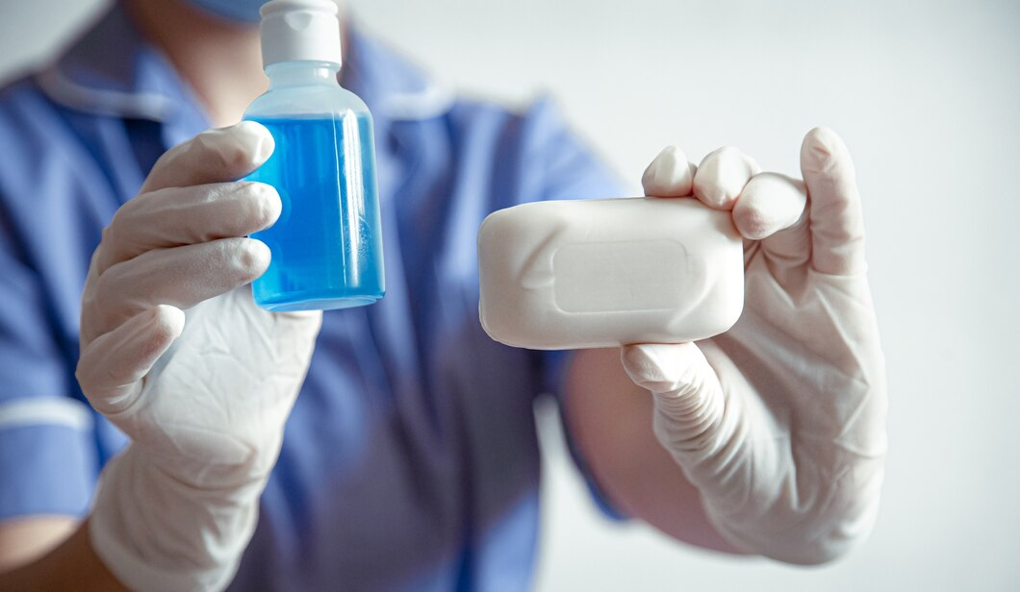
2.4.9 Aseptic Technique
The five fundamental principles of the aseptic technique are the following:
Sequencing
Environmental control
Hand hygiene
Maintenance of aseptic fields
Personal protective equipment (PPE)
Follow Standard and Transmission-Based Precautions for Infection Prevention and Control in the Work Setting

Slide 80
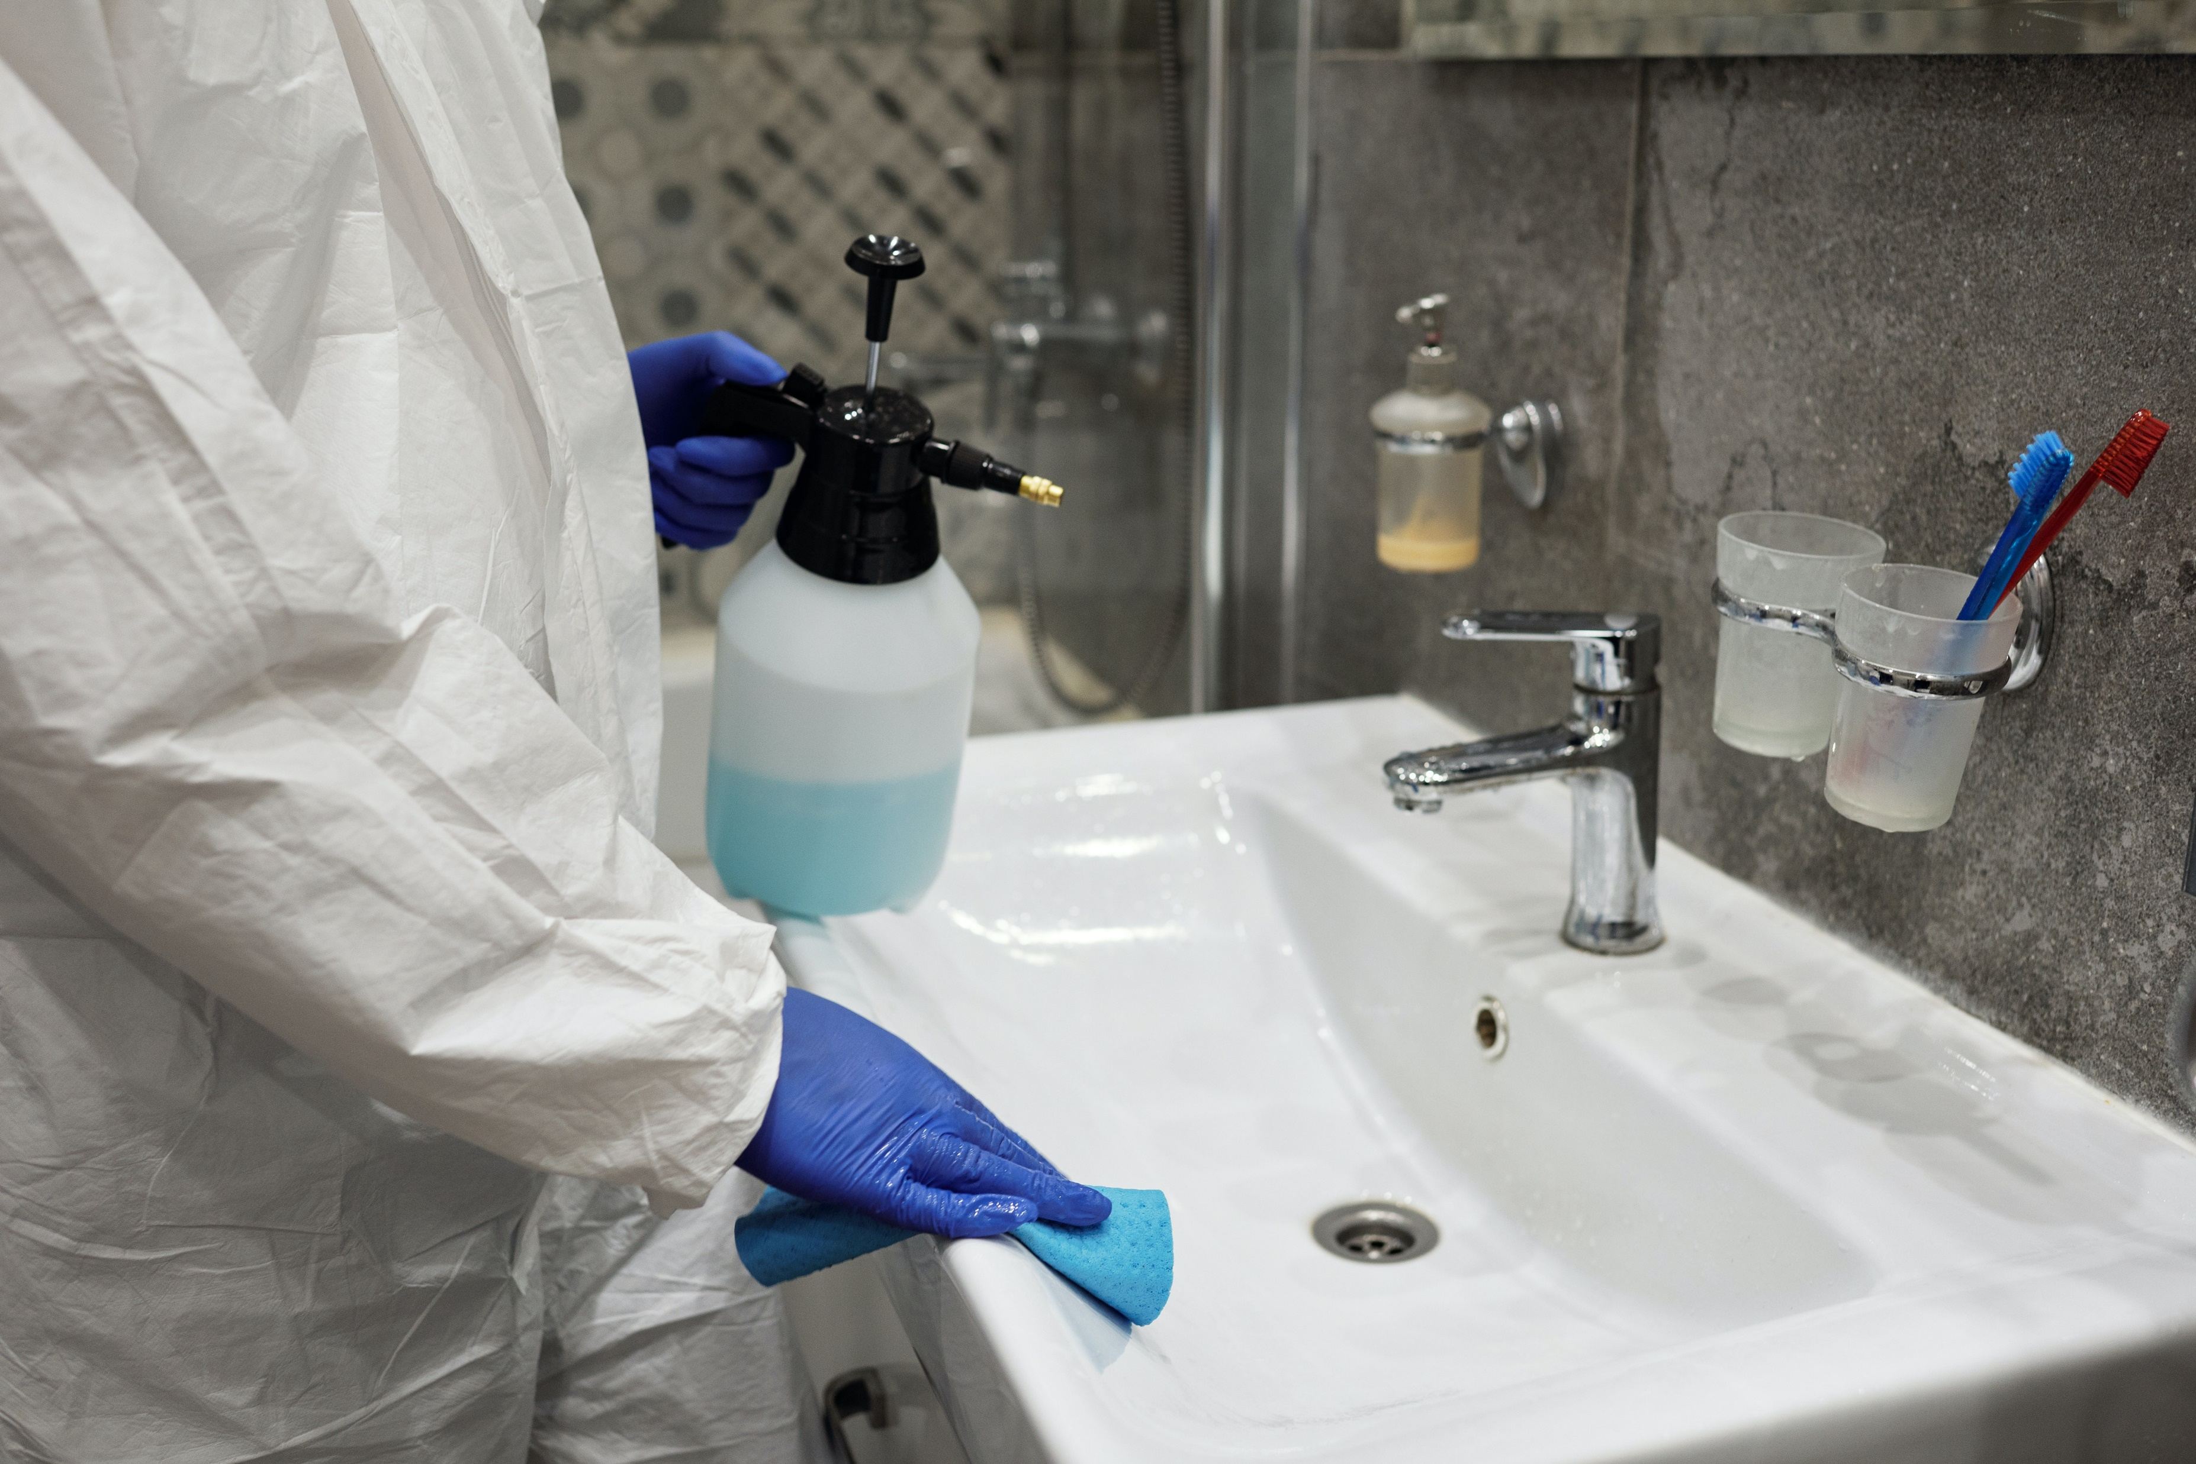
2.5 Respond Using Transmission-Based Precautions or Enhanced Cleaning

Slide 81
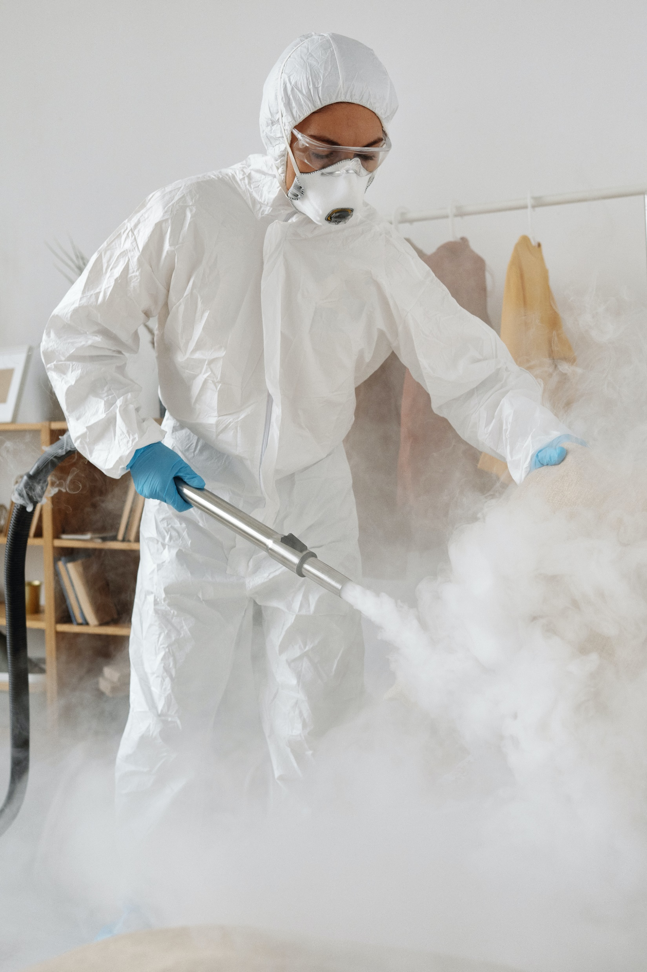
Standard precautions are steps that are undertaken regardless of infection status.
If an infectious epidemic is proven or probable, more precautions must be taken.
Two of these additional precautions are as follows:
Enhanced cleaning
Transmission-based precautions
Follow Standard and Transmission-Based Precautions for Infection Prevention and Control in the Work Setting

Slide 82
2.5.1 Identifying Situations Where Additional Precaution is Required
Here are some ideas for identifying circumstances where extra vigilance is required:
Monitor signs of possible infection outbreaks
Watch for the common symptoms of infection
Follow Standard and Transmission-Based Precautions for Infection Prevention and Control in the Work Setting

Slide 83
2.5.2 Responding to Situations Where Additional Precaution is Required
Transmission-based precautions based on transmission routes are as follows:
Contact precautions
Airborne precautions
Droplet precautions
Follow Standard and Transmission-based Precautions

Slide 84
2.5.3 Identifying Situations Where Enhanced Cleaning is Required
The following areas are at high risk of contamination:
Stairwells
Washrooms
Canteen
Staff room
Medication room
Follow Standard and Transmission-Based Precautions for Infection Prevention and Control in the Work Setting

Slide 85
The following high-touch surfaces or regularly touched things in public or communal areas must also be cleaned more thoroughly:
Doorknobs or doorhandles
Elevator buttons
Handrails
Faucet handles
Sinks
Toilet flush handles
Touch screens
Counters
Communal tables
Light switches
Cabinet handles
Follow Standard and Transmission-Based Precautions for Infection Prevention and Control in the Work Setting

Slide 86
2.5.4 Responding to Situations Where Enhanced Cleaning is Required
Be familiar with your organisation's enhanced cleaning policies and procedures, such as the following:
Required tasks for enhanced cleaning
Schedule of enhanced cleaning
Frequency of enhanced cleaning
Spaces that require cleaning and disinfection
Roles and responsibilities of people in enhanced cleaning
Follow Standard and Transmission-Based Precautions for Infection Prevention and Control in the Work Setting

Slide 87

What have we learnt?
In this part of the session, we have covered:
Identify the role of infection prevention and control in the work setting
Follow standard and transmission-based precautions for infection prevention and control in the work setting
Respond to potential and actual exposure to infection risks within scope of own role

Slide 88
End of Chapter 2

